Slide 1

RASD
- Darwin Core Data Package
Gaia Resources
+61 8 9227 7309
Level 6, FLUX 191 St Georges Terrace, Perth
enquiries@gaiaresources.com.au

Slide 2
RASD - Darwin Core Data Package
RASD and DwC model

Slide 3
Field Name | Purpose | Potential Values
dwc:occurrenceID | Link to core occurrence record | Integers, UUIDs
treatmentID | Identifier for treatment | Integers, UUIDs
treatmentField | The field in the occurrence record that has been treated. | IRI for the field
treatmentReason | To identify the reason the field that has been modified | IRI for the RASD Reason
treatmentType | To identify the type of treatment that has been applied | IRI for the RASD Treatment
treatmentDescription | To describe the scale or methodology that has been used in the application of the treatment. | Text
treatmentStartDate | If the treatment is only applied for a particular time period. | Blank if not applicable, otherwise a date to at least day precision in a standard format (e.g. ISO 8601)
treatmentEndDate | The date after which the treatment will no longer be applied. | Blank if not applicable, otherwise a date to at least day precision in a standard format (e.g. ISO 8601)
treatmentOrganisation | The organisation that requested the modification | Should link to an entry in the person/organisation section of the metadata.
treatmentInEffect | Where multiple treatments are listed for a single field, used to indicate which treatment is the one that has been published in the core file. | Boolean.
Darwin Core - RASD extension
- Occurrence example framework from last meeting

Slide 4
Darwin Core - RASD extension - Occurrence example
DwC
RASD extension
dwc: occurrenceID … | dwc: scientific Name … | treatmentID | treatment Field | treatment Reason | treatment Type | treatment Description | treatment StartDate | treatment EndDate | treatment Organisation | treatment InEffect

Slide 5
RASD - Darwin Core Data Package
Packaging
DwC-A vs DwC-DP

Slide 6
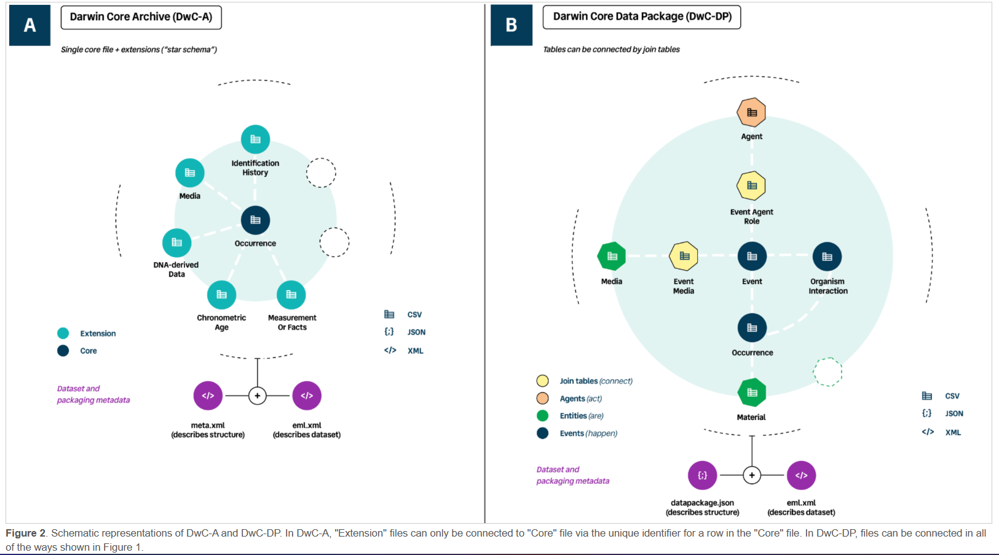
https://gbif.github.io/dwc-dp/qrg/#dwca

Slide 7
Treatment
(need to add “coreID” field to schema when packaging for DwC-A)

Slide 8
3 different ways to connect classes:
Direct
Subclass
Join tables

Slide 9
RASD - Darwin Core Data Package
DwC-DP
Connection options

Slide 10
Exploring DwC-DP connections
Generic
Existing example
Applied to Treatments
Pros and Cons

Slide 11
RASD - Darwin Core Data Package
DwC-DP
Direct connections

Slide 12
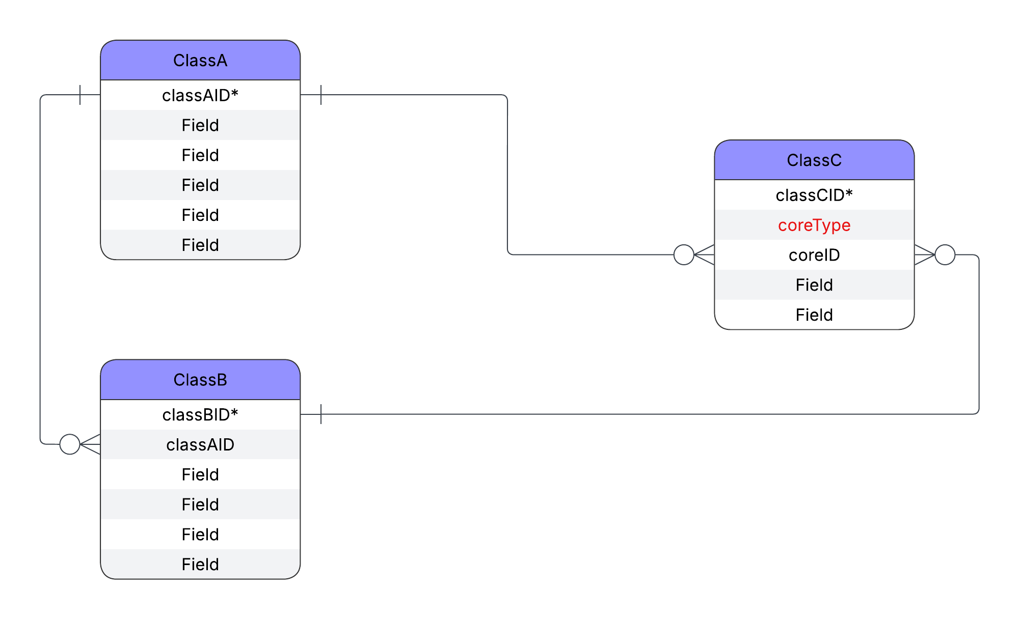
DwC-DP -
Direct connection
Generic

Slide 13
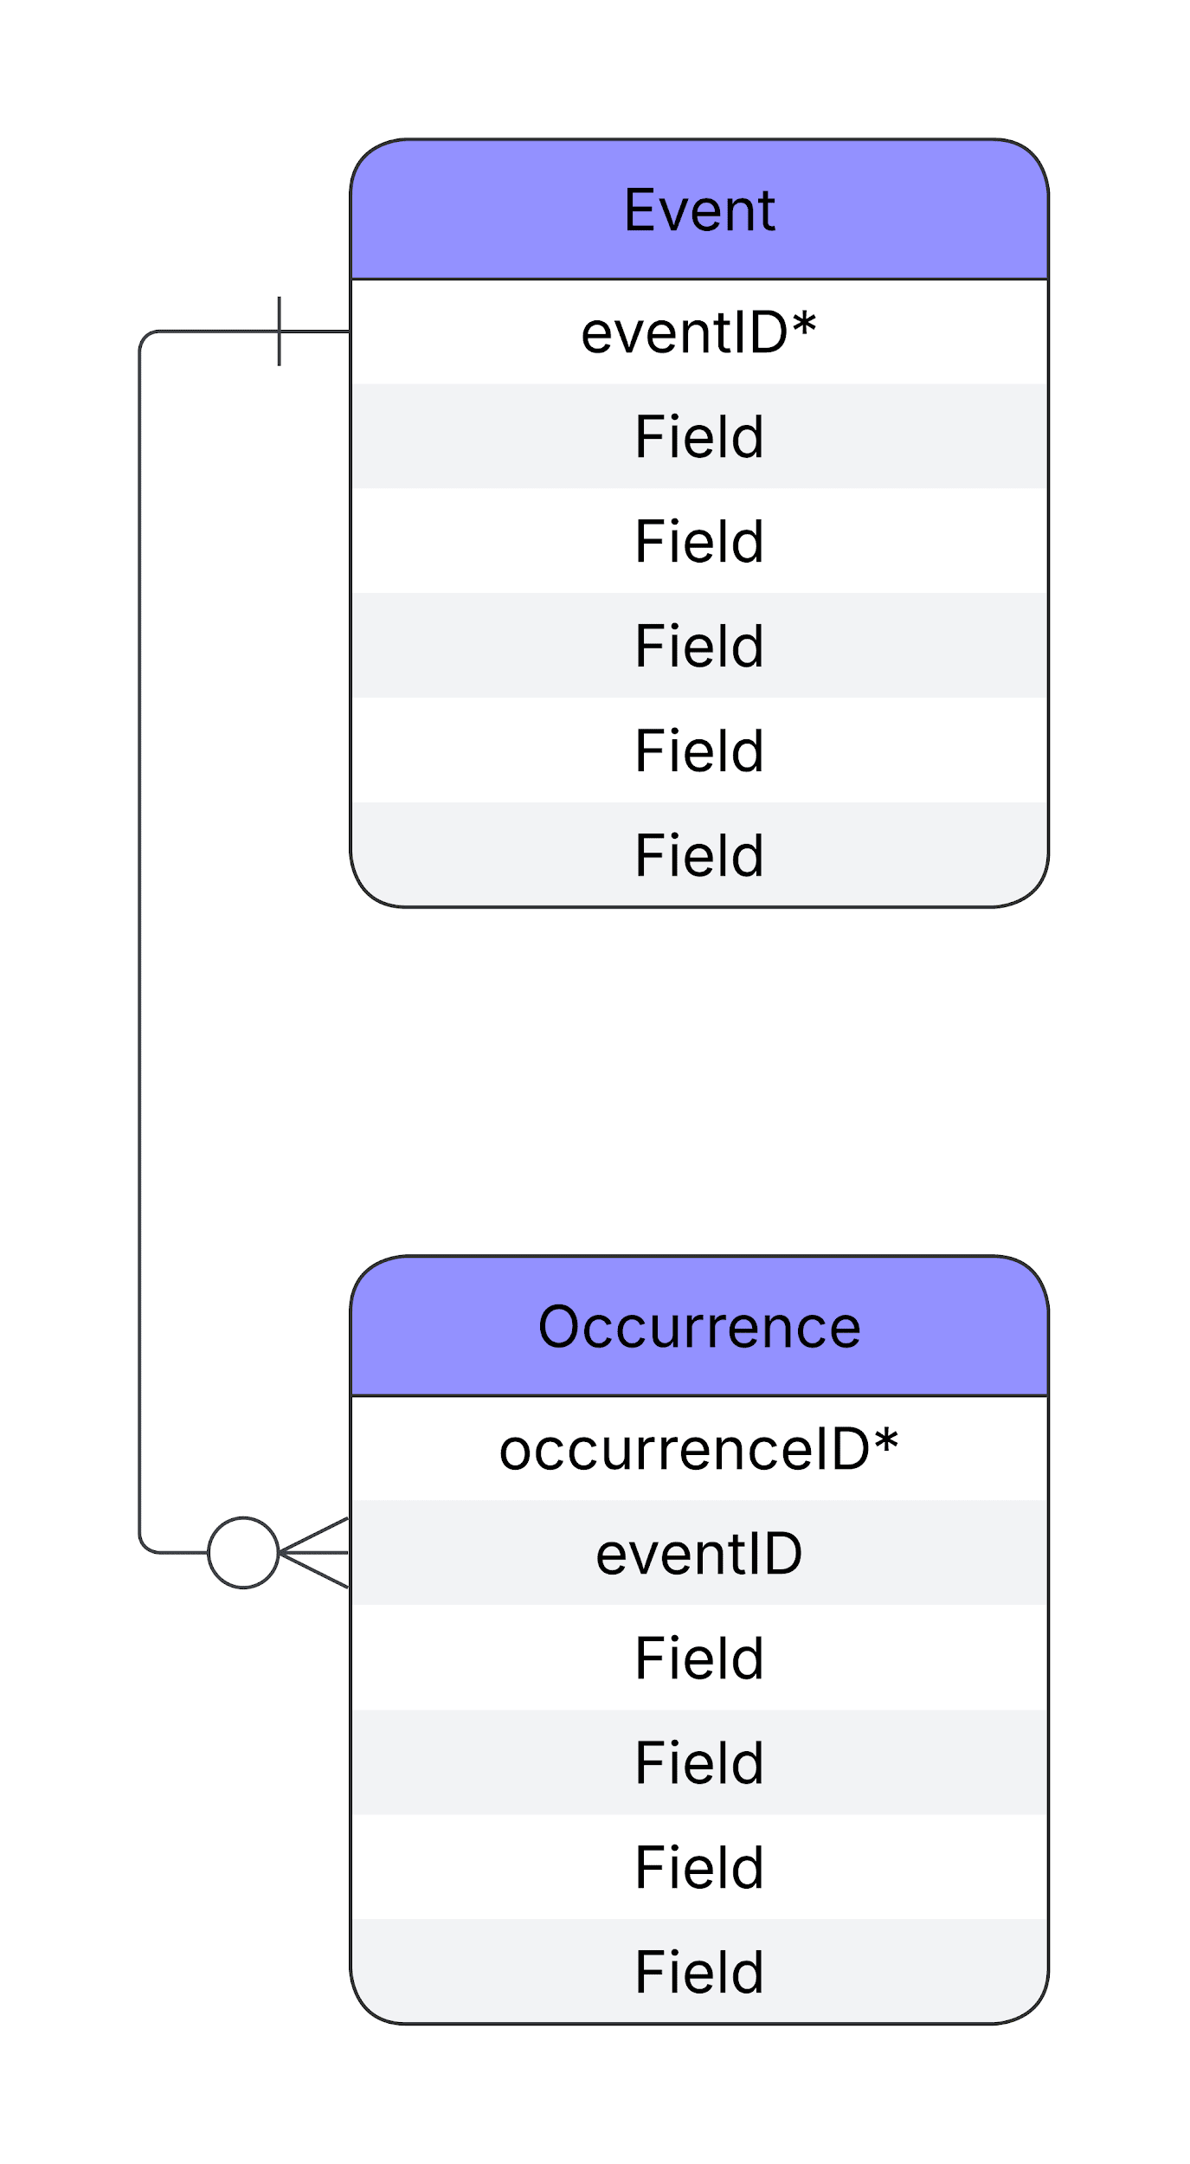
DwC-DP -
Direct connection
Existing example

Slide 14
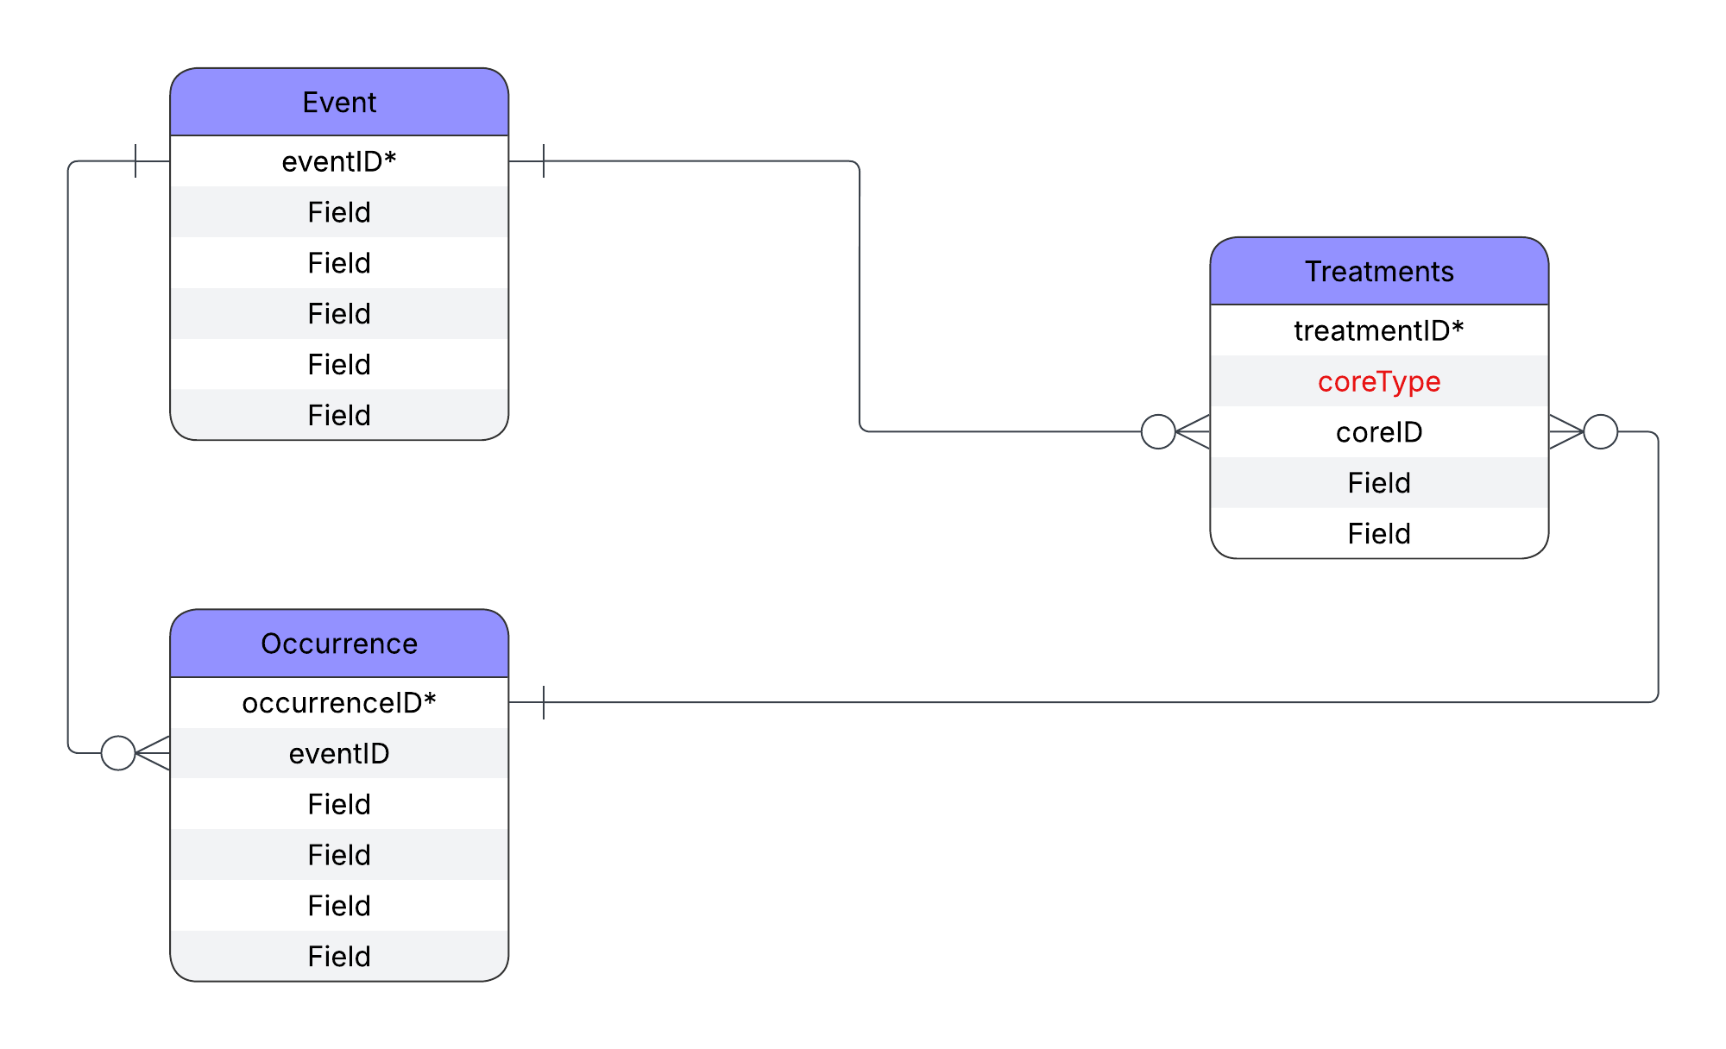
DwC-DP -
Direct connection
Event or Occurrence
Applied to Treatments
eventID or occurrenceID

Slide 15
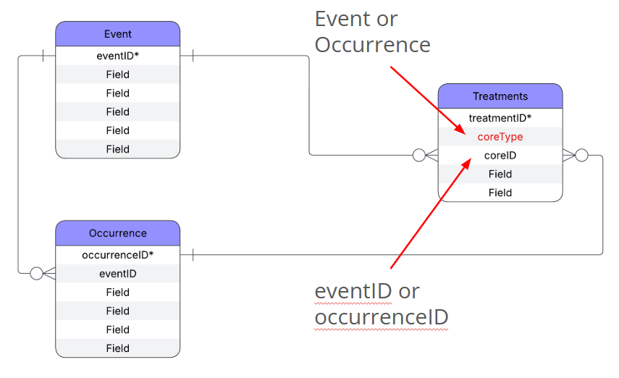
DwC-DP -
Direct connection
Pros
All Treatments easily findable in one table
System that most closely convertible to RDF
Filterable by type
Cons
Redundancy (when in a relational table system) if the same Treatment is applied to multiple instances/multiple core entities

Slide 16
RASD - Darwin Core Data Package
DwC-DP
Subclass connections

Slide 17
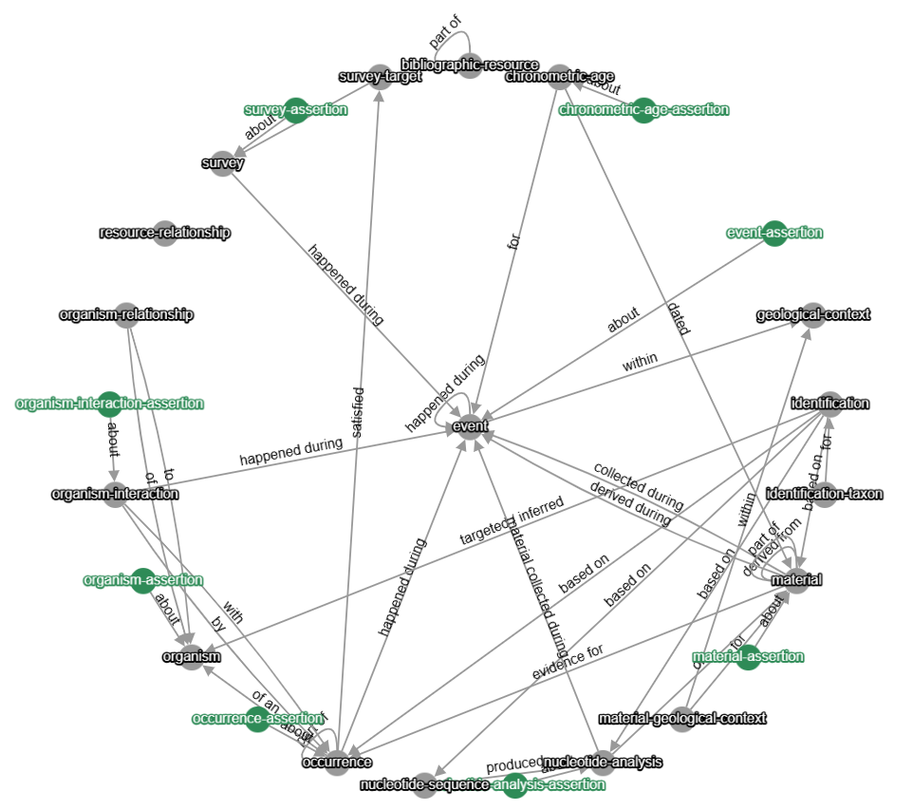
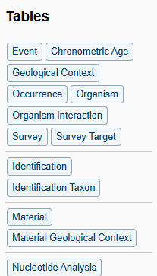
DwC-DP
Assertions ~ subclasses
Not listed individually in the quick reference guide

Slide 18
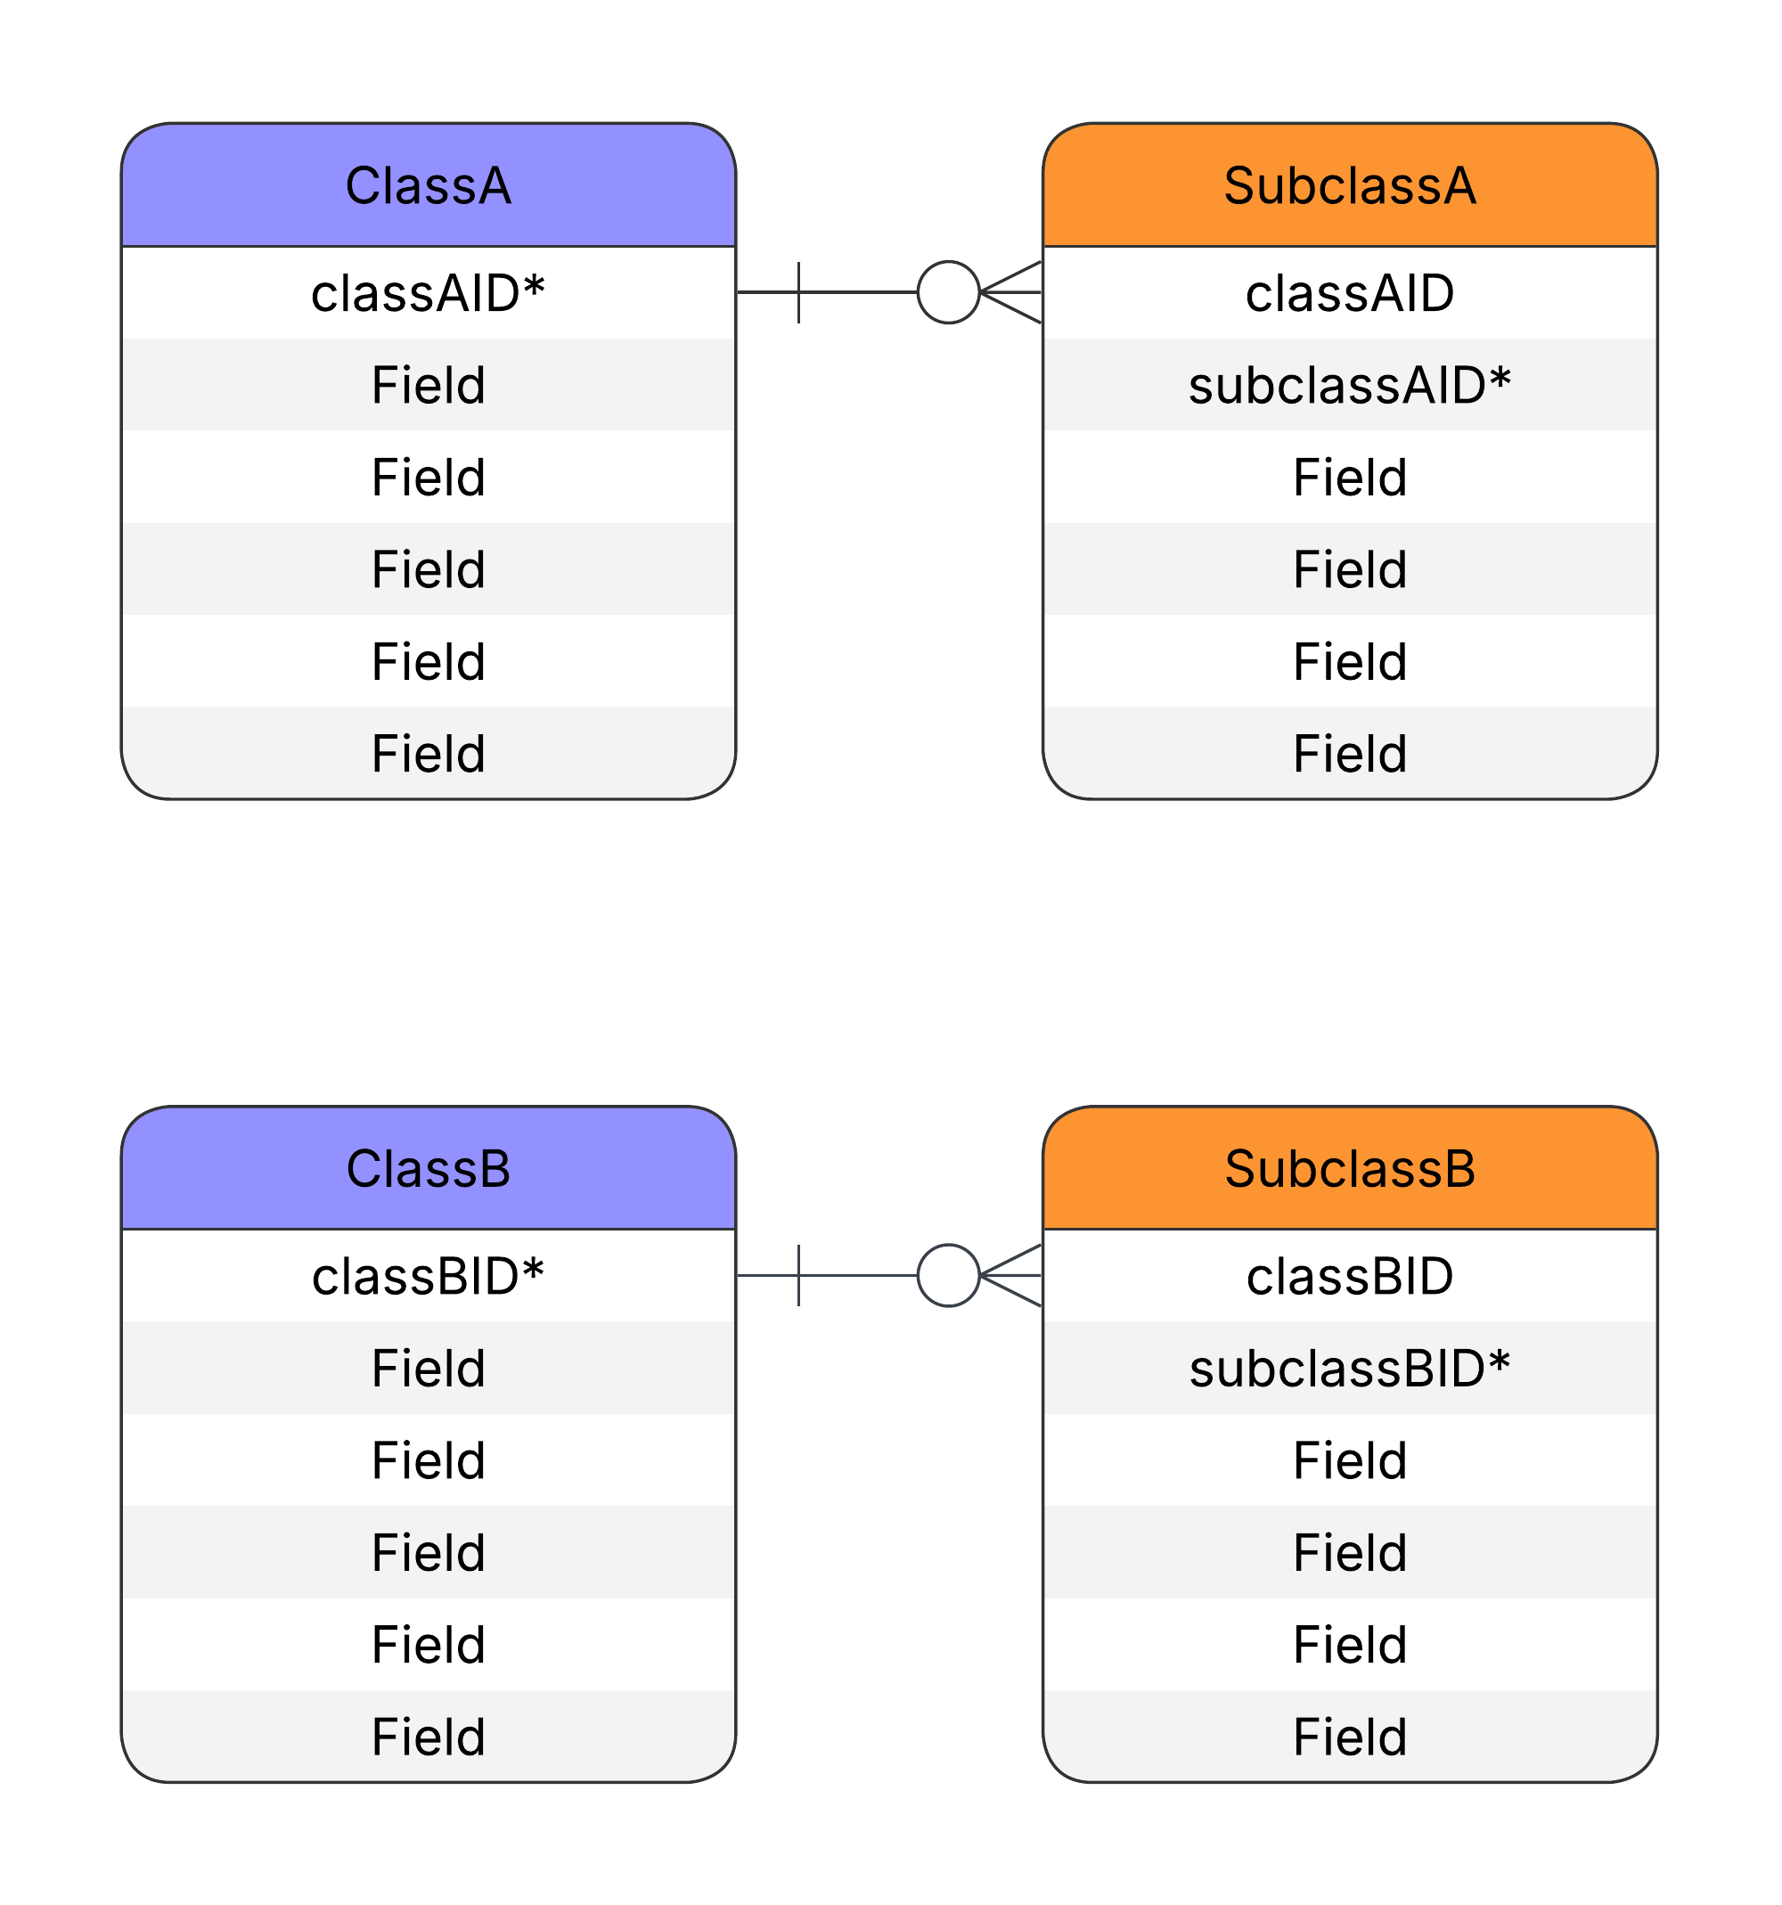
DwC-DP -
Subclass
Generic

Slide 19
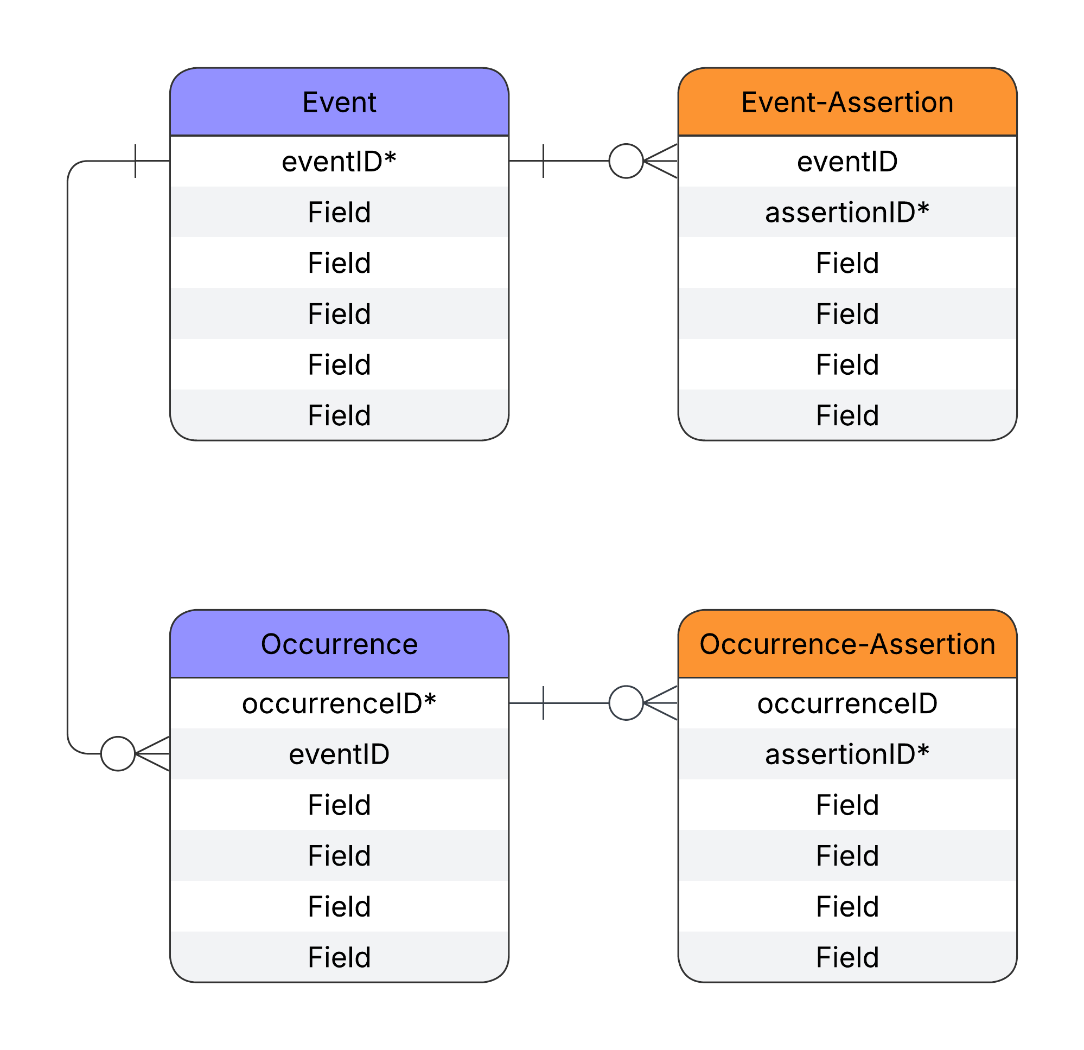
DwC-DP -
Subclass
Existing example

Slide 20

DwC-DP -
Subclass
Applied to Treatments

Slide 21
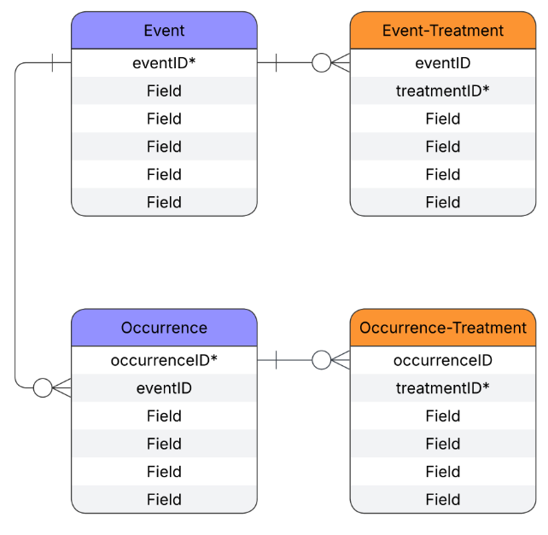
DwC-DP -
Subclass
Pros
Treatments associated with core entity
System that most closely resembles the DwC-A
Cons
Redundancy if the same Treatment is applied to multiple instances/core entities

Slide 22
RASD - Darwin Core Data Package
DwC-DP
Join tables

Slide 23
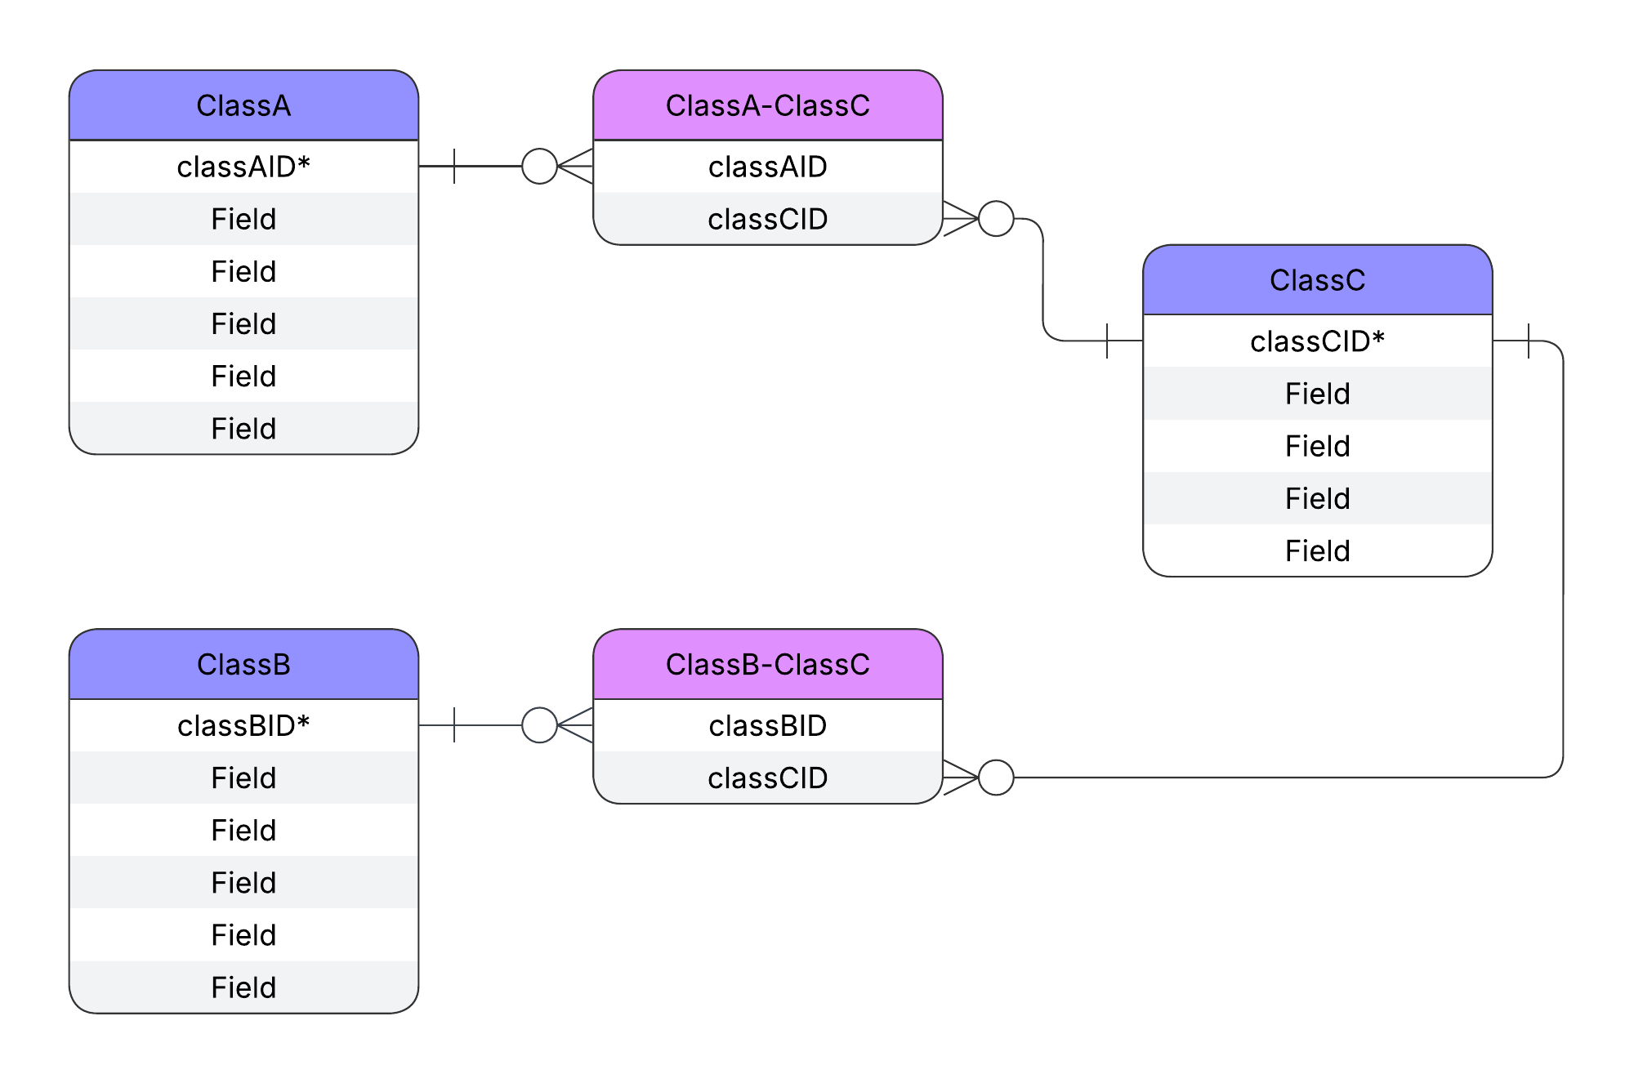
DwC-DP -
Join tables
Generic

Slide 24
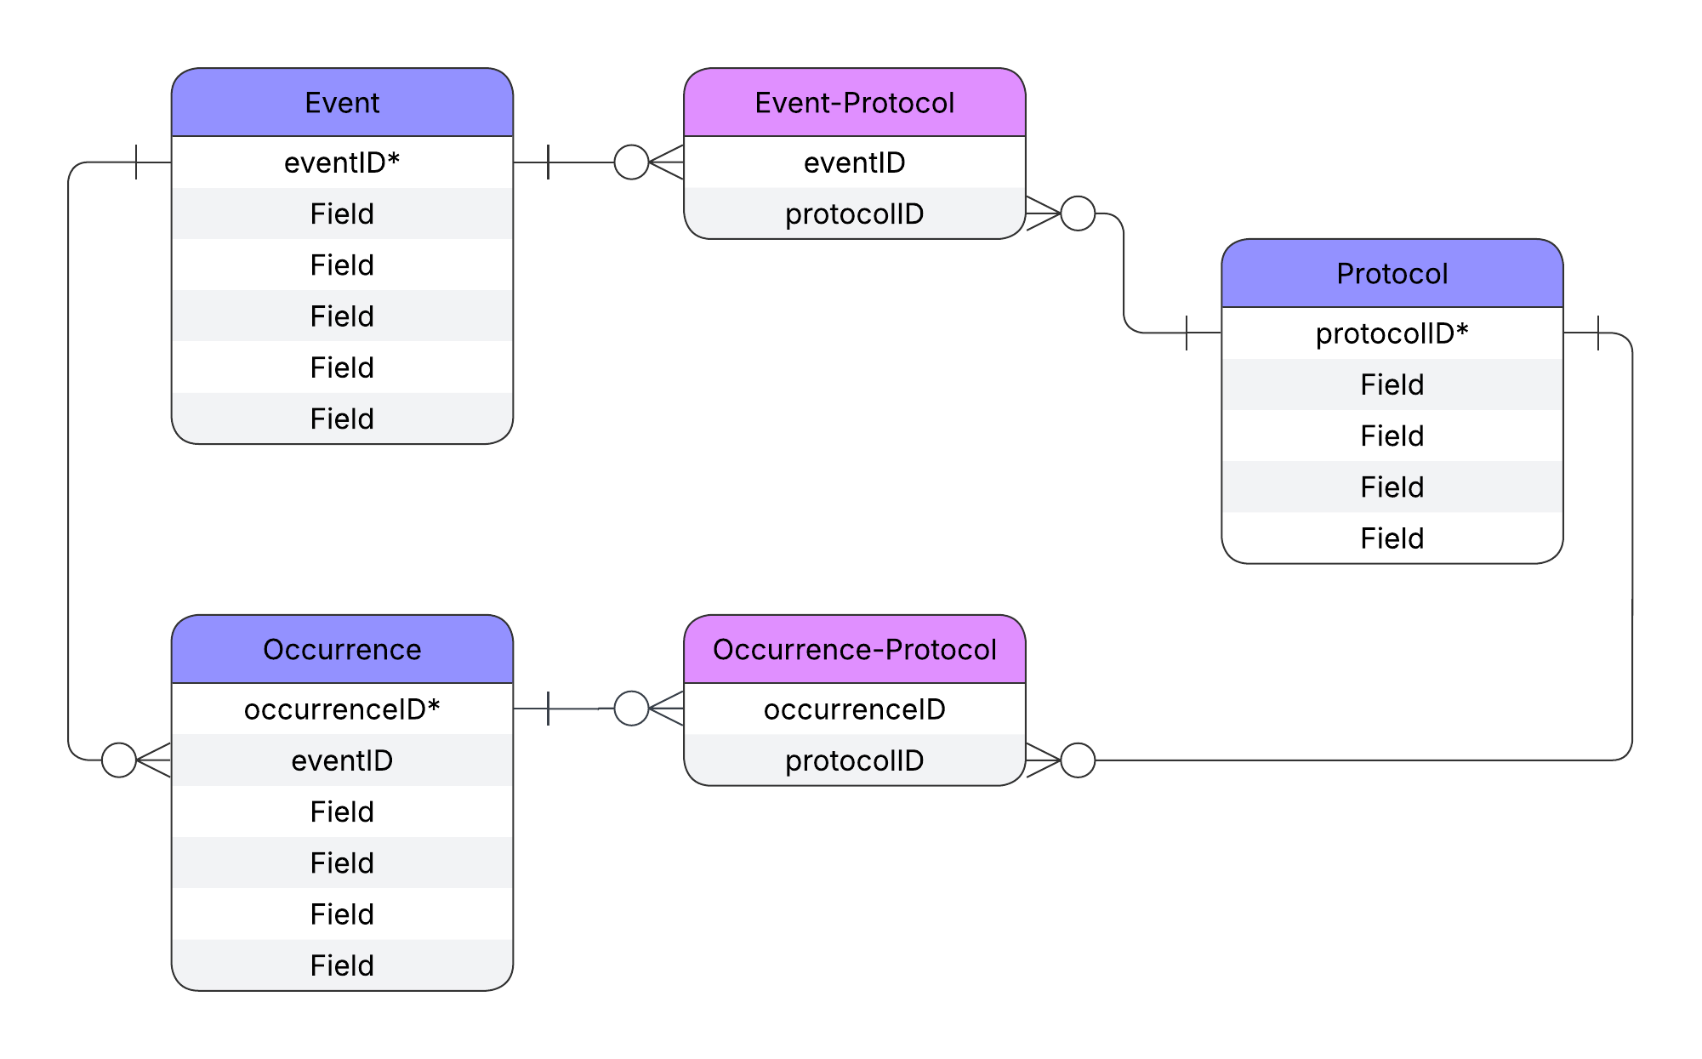
DwC-DP -
Join tables
Existing example

Slide 25

DwC-DP -
Join tables
Applied to Treatments

Slide 26
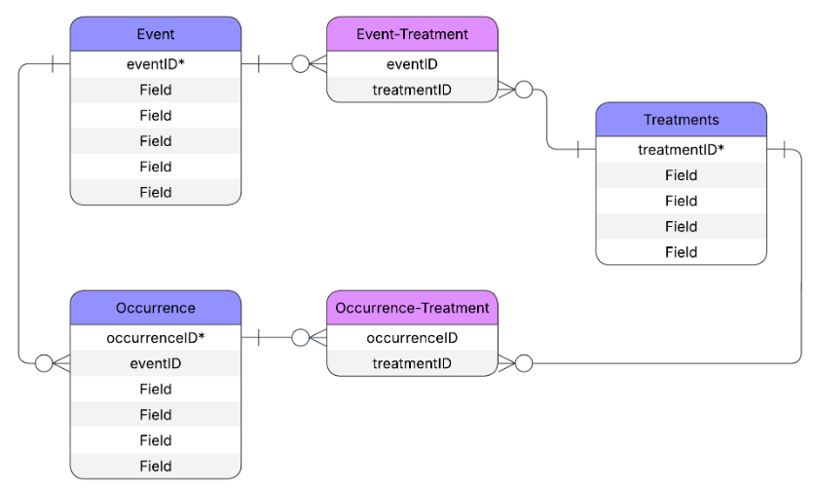
DwC-DP -
Join tables
Pros
All Treatments easily findable in one table
System that most closely resembles relational database
Saves redundancy by using the relationship join table rather than repeating the details if Treatments are re-used.

Slide 27
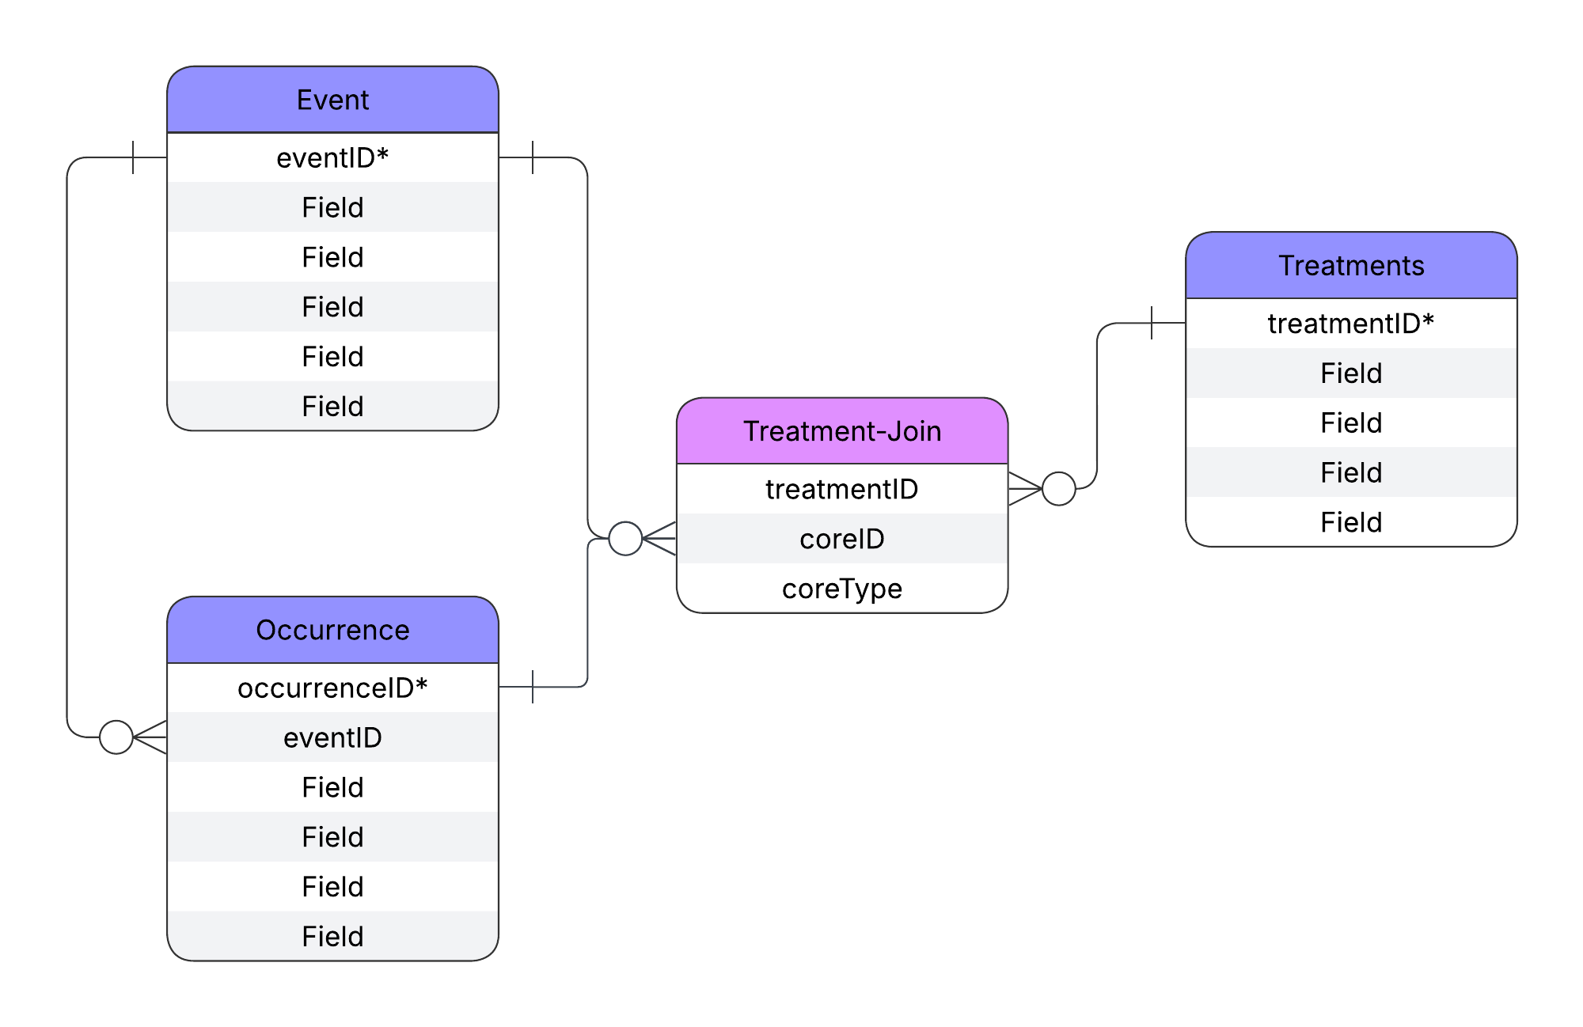
DwC-DP -
Combined join table
Pros
All Treatments easily findable in one table
Fewer join tables
Saves redundancy by using the relationship join table rather than repeating the details if Treatments are re-used.
Cons
Rare pattern for DwC-DP. Precedent = Chronometric Age Reference

Slide 28
RASD - Darwin Core Data Package
DwC-DP
Join table schemas

Slide 29
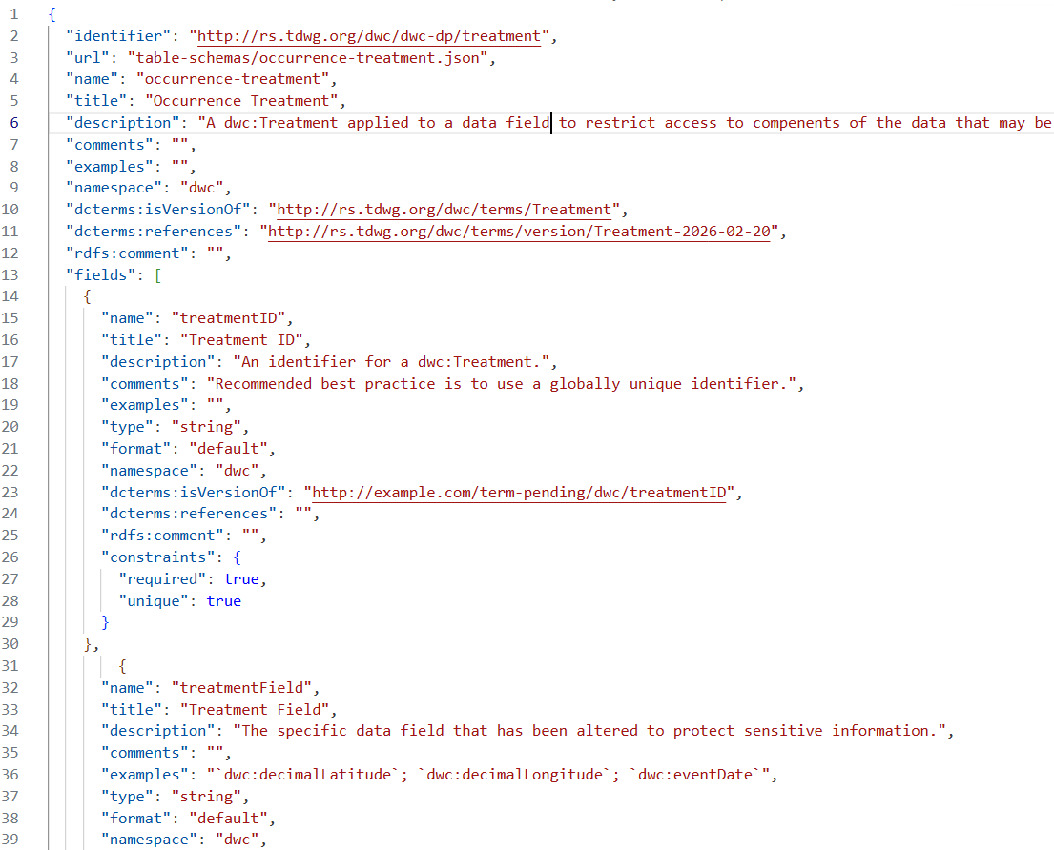
Treatments

Slide 30
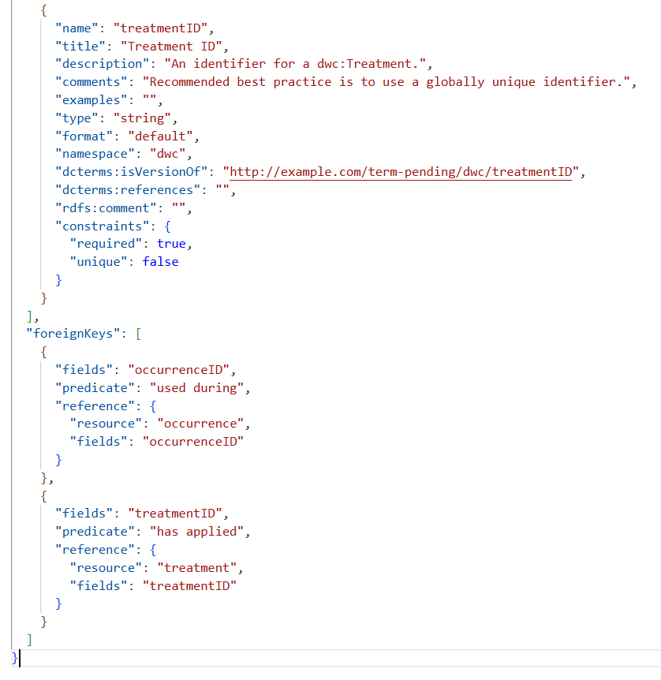
Join
Occurrence example

Slide 31
Thank you.
Gaia Resources
+61 8 9227 7309
Level 6, FLUX 191 St Georges Terrace, Perth
enquiries@gaiaresources.com.au

